Slide 1
UNIT V
EVENT DRIVEN PROGRAMMING
Graphics programming – Frame – Components – working with 2D shapes – Using color, fonts, and images – Basics of event handling – event handlers – adapter classes – actions – mouse events – AWT event hierarchy – Introduction to Swing – layout management – Swing Components – Text Fields , Text Areas – Buttons- Check Boxes – Radio Buttons – Lists- choices- Scrollbars – Windows –Menus – Dialog Boxes.

Slide 2
Introducing the AWT: Working with Windows, Graphics, and Text
Abstract Window Toolkit (AWT)
contains numerous classes and methods that allow to create and manage windows
also the foundation upon which Swing is built
AWT is quite large
to create and manage windows, manage fonts, output text, and utilize graphics
To describes the various controls, such as scroll bars and push buttons
a common use of the AWT is in applets, it is also used to create stand-alone windows that run in a GUI environment, such as Windows

Slide 3
most Java programs employ user interfaces based on Swing. Because Swing provides richer implementations than does the AWT of some common GUI controls, such as buttons, lists, and check boxes, it is easy to jump to the conclusion that the AWT is no longer important, that it has been superseded by Swing.
Swing is built on top of the AWT.
Thus, many aspects of the AWT are also aspects of Swing.
many AWT classes are used either directly or indirectly by Swing.
some types of small programs (especially small applets) that make only minimal use of a GUI, using the AWT rather than Swing still makes sense. Therefore, even though most interfaces today will be based on Swing, a solid knowledge of the AWT is still required.
you can’t be a great Java programmer without knowing the AWT.

Slide 4
The AWT classes are contained in the java.awt package. It is one of Java’s largest packages.
Fortunately, because it is logically organized in a top-down, hierarchical fashion, it is easier to understand and use

Slide 5
Class & Description:
AWTEvent - Encapsulates AWT events.
AWTEventMulticaster - Dispatches events to multiple listeners.
BorderLayout - The border layout manager. Border layouts use five components: North, South, East, West, and Center.
Button - Creates a push button control.
Canvas - A blank, semantics-free window.
CardLayout - The card layout manager. Card layouts emulate index cards. Only the one on top is showing.
Checkbox - Creates a check box control.
CheckboxGroup - Creates a group of check box controls.
CheckboxMenuItem - Creates an on/off menu item.
Choice - Creates a pop-up list.
Color - Manages colors in a portable, platform-independent fashion.
Component - An abstract superclass for various AWT components.
Container - A subclass of Component that can hold other components.
Cursor - Encapsulates a bitmapped cursor.

Slide 6
Dialog - Creates a dialog window.
Dimension - Specifies the dimensions of an object. The width is stored in width, and the height is stored in height.
Event - Encapsulates events.
EventQueue - Queues events.
FileDialog - Creates a window from which a file can be selected.
FlowLayout - The flow layout manager. Flow layout positions components left to right, top to bottom.
Font - Encapsulates a type font.
FontMetrics - Encapsulates various information related to a font. This information helps you display text in a window.
Frame - Creates a standard window that has a title bar, resize corners, and a menu bar
Graphics - Encapsulates the graphics context. This context is used by the various output methods to display output in a window.
GraphicsDevice - Describes a graphics device such as a screen or printer.

Slide 7
GraphicsEnvironment - Describes the collection of available Font and GraphicsDevice objects.
GridBagConstraints - Defines various constraints relating to the GridBagLayout class.
GridBagLayout - The grid bag layout manager. Grid bag layout displays components subject to the constraints specified by GridBagConstraints.
GridLayout - The grid layout manager. Grid layout displays components in two-dimensional grid.
Image - Encapsulates graphical images.
Insets - Encapsulates the borders of a container.
Label - Creates a label that displays a string.
List - Creates a list from which the user can choose. Similar to the standard Windows list box.
MediaTracker - Manages media objects.
Menu - Creates a pull-down menu.
MenuBar - Creates a menu bar.
MenuComponent - An abstract class implemented by various menu classes.
MenuItem - Creates a menu item.
MenuShortcut - Encapsulates a keyboard shortcut for a menu item.

Slide 8
Panel - The simplest concrete subclass of Container.
Point - Encapsulates a Cartesian coordinate pair, stored in x and y.
Polygon - Encapsulates a polygon.
PopupMenu - Encapsulates a pop-up menu.
PrintJob - An abstract class that represents a print job.
Rectangle - Encapsulates a rectangle.
Robot - Supports automated testing of AWT-based applications.
Scrollbar - Creates a scroll bar control.
ScrollPane - A container that provides horizontal and/or vertical scroll bars for another component.
SystemColor - Contains the colors of GUI widgets such as windows, scroll bars, text, and others.
TextArea - Creates a multiline edit control.
TextComponent - A superclass for TextArea and TextField.
TextField - Creates a single-line edit control.
Toolkit - Abstract class implemented by the AWT.
Window - Creates a window with no frame, no menu bar, and no title.

Slide 9
Window Fundamentals
Component
Container
Window
Panel
Frame
Canvas

Slide 11
Component
The Component class is at the top of the AWT hierarchy. It is an abstract class that encapsulates all of the attributes of a visual component. All user interface elements that are displayed on the screen and that interact with the user are subclasses of Component.
Container
The Container class is a subclass of Component class. It has additional methods that allow other Component objects to be nested within it. Other Container objects can be stored inside of a Container.
Panel
The Panel class is a concrete subclass of Container. It doesn’t add any new methods and implements Container. Panel is the superclass for Applet. When screen output is directed to an applet, it is drawn on the surface of a Panel object. A Panel is a window that does not contain a title bar, menu bar, or border.

Slide 12
Window
The Window class creates a top-level window. It is not contained within any other object. It sits directly on the desktop.
Frame
Frame encapsulates a “window.” It is a subclass of Window and has a title bar, menu bar, borders, and resizing corners.
Canvas
It is not considered as a part of the hierarchy for applet or frame windows. Canvas encapsulates a blank window upon which you can draw.

Slide 13
Graphics class
an abstract class that provides the means to access different graphics devices.
to draw images on the screen, display images, and so forth.
can call all the methods of the Graphics class without caring about platform specific classes.
We rarely need to create a Graphics object yourself; its constructor is protected and is only called by the subclasses that extend Graphics. A Graphics object is always available when you override a component's paint() and update() methods. It is the sole parameter of the Component.paint() and Component.update() methods.
to get a graphics context of a Component call Component.getGraphics().
defines a number of drawing functions.
Each shape can be drawn edge-only or filled.
Objects are drawn and filled in the currently selected graphics color, which is black by default.
When a graphics object is drawn that exceeds the dimensions of the window, output is automatically clipped.

Slide 14
Drawing Strings
To draw text strings on the screen.
The coordinates refer to the left end of the text's baseline.
public abstract void drawString (String text, int x, int y) :-
This method draws text which is specified as the method’s argument on the screen in the current font and color, starting at position (x, y).
public void drawChars (char text[], int offset, int length, int x, int y):- The drawChars() method creates a String from the char array text starting at text[offset] and continuing for length characters. The newly created String is then drawn on the screen in the current font and color, starting at position (x, y). The starting coordinates specify the left end of the String's baseline.
public void drawBytes (byte text[], int offset, int length, int x, int y):- The drawBytes() method creates a String from the byte array text starting at text[offset] and continuing for length characters. This String is then drawn on the screen in the current font and color, starting at position (x, y). The starting coordinates specify the left end of the String's baseline.

Slide 15
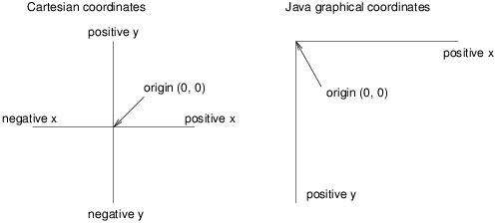
You are probably used to Cartesian coordinates, where x and y values can be positive or negative. In contrast, Java uses a coordinate system where the origin is in the upper-left corner. That way, x and y are always positive integers. Figure B.1 shows these coordinate systems.

Slide 16
Drawing Lines
public abstract void drawLine (int x1, int y1, int x2, int y2):-
draws a line on the graphics context in the current color that begins at startX,startY and ends at endX,endY.
If (x1, y1) and (x2, y2) are the same point, it will draw a point. There is no method specific to drawing a point.
The following example illustrates the above method:

Slide 17
import java.awt.*;
import java.applet.*;
/* <applet code="Rectangles" width=300 height=200> </applet> */
public class Lines extends Applet {
public void init() {
setBackground (Color.black);
setForeground(Color.green);
}
public void paint(Graphics g) {
g.drawLine(0, 0, 100, 100);
g.drawLine(0, 100, 100, 0);
g.drawLine(40, 25, 250, 180);
g.drawLine(75, 90, 400, 400);
g.drawLine(20, 150, 400, 40); //line
g.drawLine(5, 290, 80, 19); //line
g.drawLine (5, 75, 5, 75); // point
g.drawLine (50, 5, 50, 5); // point
} }

Slide 18
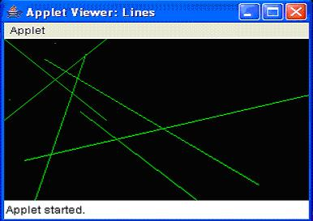
Output

Slide 19
Drawing Rectangle
public void drawRect (int x, int y, int width, int height):-
draws a rectangle on the drawing area in the current color from (x, y) to (x+width, y+height).
If width or height is negative, nothing is drawn.
public abstract void fillRect (int x, int y, int width, int height):-
draws a filled rectangle on the drawing area in the current color from (x, y) to (x+width-1, y+height-1).
The filled rectangle is one pixel smaller to the right and bottom than requested.
If width or height is negative, nothing is drawn.

Slide 20
public abstract void drawRoundRect (int x, int y, int width, int height, int arcWidth, int arcHeight):-
draws a rectangle on the drawing area in the current color from (x, y) to (x+width, y+height).
Instead of perpendicular corners, the corners are rounded with a horizontal diameter of arcWidth and a vertical diameter of arcHeight.
If width or height is a negative number, nothing is drawn.
If width, height, arcWidth, and arcHeight are all equal, you get a circle.
public abstract void fillRoundRect (int x, int y, int width, int height, int arcWidth, int arcHeight):-
similar to drawRoundRect() method except that it draws a filled rectangle on the drawing area in the current color from (x, y) to (x+width-1, y+height-1).
If width, height, arcWidth, and arcHeight are all equal, you get a filled circle.

Slide 21
import java.awt.*;
import java.applet.*;
/*
<applet code="Rectangles" width=300 height=200>
</applet>
*/
public class Rectangles extends Applet {
public void init() {
setBackground(Color.black);
setForeground(Color.green);
}
public void paint(Graphics g) {
g.drawRect(10, 10, 60, 50);
g.fillRect(100, 10, 60, 50);
g.drawRoundRect(190, 10, 60, 50, 15, 15);
g.fillRoundRect(70, 90, 140, 100, 30, 40);
}}

Slide 22
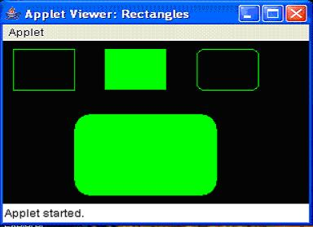

Slide 23
public void draw3DRect (int x, int y, int width, int height, boolean raised):-
draws a rectangle in the current color from (x, y) to (x+width, y+height).
A shadow effect makes the rectangle appear to float slightly above or below the screen.
The raised parameter has an effect only if the current color is not black.
If raised is true, the rectangle looks like a button waiting to be pushed.
If raised is false, the rectangle looks like a depressed button.
If width or height is negative, the shadow appears from another direction.
public void fill3DRect (int x, int y, int width, int height, boolean raised):-
similar to the draw3DRect ( ) method except that it draws a filled rectangle in the current color from (x, y) to (x+width,y+height)..
If width or height is negative, the shadow appears from another direction, and the rectangle isn't filled.

Slide 24
import java.awt.*;
import java.applet.*;
/*
<applet code="Rectangles3D" width=300 height=200>
</applet>
*/
public class Rectangles3D extends Applet {
public void init() {
setBackground(Color.black);
}
public void paint(Graphics g) {
g.setColor (Color.gray);
g.draw3DRect (25, 10, 50, 75, true);
g.draw3DRect (25, 110, 50, 75, false);
g.fill3DRect (100, 10, 50, 75, true);
g.fill3DRect (100, 110, 50, 75, false);
} }

Slide 25
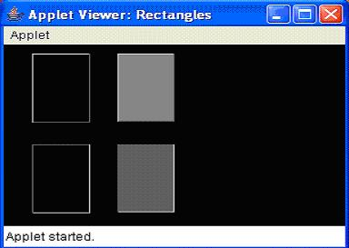

Slide 26
Drawing Ellipses and Circles and Ovals
public abstract void drawOval (int x, int y, int width, int height):-
draws an oval in the current color within an invisible bounding rectangle from (x, y) to (x+width, y+height).
cannot specify the oval's center point and radii.
If width and height are equal, you get a circle.
If width or height is negative, nothing is drawn.
public abstract void fillOval (int x, int y, int width, int height):-
draws a filled oval in the current color within an invisible bounding rectangle from (x, y) to (x+width-1, y+height-1).
cannot specify the oval's center point and radii.
Notice that the filled oval is one pixel smaller to the right and bottom than requested.
If width or height is negative, nothing is drawn.

Slide 27
import java.awt.*;
import java.applet.*;
/*
<applet code="Ovals" width=300 height=200>
</applet>
*/
public class Ovals extends Applet {
public void init() {
setBackground(Color.black);
setForeground(Color.green);
}
public void paint(Graphics g) {
g.drawOval(10, 10, 50, 50);
g.fillOval(100, 10, 75, 50);
g.drawOval(190, 10, 90, 30);
g.fillOval(70, 90, 140, 100);
}
}

Slide 28
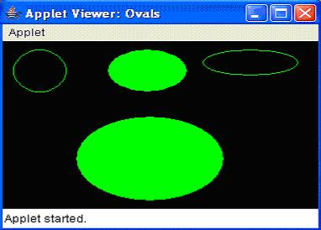

Slide 29
Drawing Arcs
public abstract void drawArc (int x, int y, int width, int height, int startAngle, int arcAngle):-
draws an arc in the current color within an invisible bounding rectangle from (x,y) to (x+width, y+height).
The arc starts at startAngle degrees and goes to startAngle + arcAngle degrees.
An angle of 0 degrees is at the 3 o'clock position; angles increase counter-clockwise.
If arcAngle is negative, drawing is in a clockwise direction.
If width and height are equal and arcAngle is 360 degrees, drawArc() draws a circle.
If width or height is negative, nothing is drawn.
public abstract void fillArc (int x, int y, int width, int height, int startAngle, int arcAngle):-
similar to the drawArc() method except that it draws a filled arc in the current color within an invisible bounding rectangle from (x, y) to (x+width-1, y+height-1.
If width and height are equal and arcAngle is 360 degrees, fillArc() draws a filled circle.

Slide 30
import java.awt.*;
import java.applet.*;
/*
<applet code="Arcs" width=300 height=200>
</applet>
*/
public class Arcs extends Applet {
public void init() {
setBackground(Color.black);
setForeground(Color.green);
}
public void paint(Graphics g) {
g.drawArc(10, 40, 70, 70, 0, 75);
g.fillArc(100, 40, 70, 70, 0, 75) ;
g.drawArc(10, 100, 70, 80, 0, 175);
g.fillArc(100, 100, 70, 90, 0, 270);
g.drawArc(200, 80, 80, 80, 0, 180);
} }

Slide 31
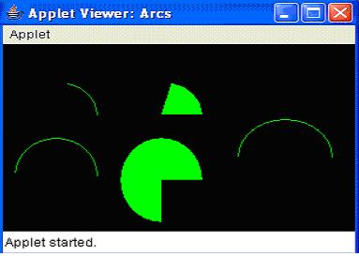

Slide 32
Drawing Polygons
public abstract void drawPolygon (int xPoints[], int yPoints[], int numPoints):-
draws a path of numPoints nodes by taking one element at a time out of xPoints and yPoints to make each point.
The path is drawn in the current color.
If either xPoints or yPoints does not have numPoints elements, drawPolygon() throws a run-time exception
public abstract void drawPolyline (int xPoints[], int yPoints[], int numPoints):-
functions like the 1.0 version of drawPolygon().
It connect the dots with the points in the xPoints and yPoints arrays and does not connect the endpoints.
If either xPoints or yPoints does not have numPoints elements, drawPolygon() throws the run-time exception, ArrayIndexOutOfBoundsException.
public abstract void fillPolygon (int xPoints[], int yPoints[], int nPoints):-
draws a polygon of numPoints nodes by plucking one element at a time out of xPoints and yPoints to make each point.
The polygon is drawn in the current color.
If either xPoints or yPoints does not have numPoints elements, fillPolygon() throws the run-time exception IllegalArgumentException.
If the polygon is not closed, fillPolygon() adds a segment connecting the endpoints.

Slide 33
import java.awt.*;
import java.applet.*;
/*
<applet code="HourGlass" width=230 height=210>
</applet>
*/
public class HourGlass extends Applet {
public void init() {
setBackground(Color.black);
setForeground(Color.green);
}
public void paint(Graphics g) {
int xpoints[] = {30, 200, 30, 200, 30};
int ypoints[] = {30, 30, 200, 200, 30};
int num = 5;
g.drawPolygon(xpoints, ypoints, num);
} }

Slide 34
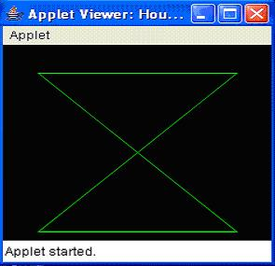

Slide 35
Another Example:
import java.applet.*;
/* <applet code="Polygons" width=230 height=210> </applet> */
public class Polygons extends Applet {
public void init() {
setBackground(Color.black);
setForeground(Color.green); }
public void paint(Graphics g) {
int[] xPoints[] = {{50, 25, 25, 75, 75}, {50, 25, 25, 75, 75}, {100, 100, 150, 100, 150, 150, 125, 100, 150},
{100, 100, 150, 100, 150, 150, 125, 100, 150}};
int[] yPoints[] = {{10, 35, 85, 85, 35, 10}, {110, 135, 185, 185, 135}, {85, 35, 35, 85, 85, 35, 10, 35, 85},
{185, 135, 135, 185, 185, 135, 110, 135, 185}};
int nPoints[] = {5, 5, 9, 9};
g.drawPolygon (xPoints[0], yPoints[0], nPoints[0]);
g.fillPolygon (xPoints[1], yPoints[1], nPoints[1]);
g.drawPolygon (new Polygon(xPoints[2], yPoints[2], nPoints[2]));
g.fillPolygon (new Polygon(xPoints[3], yPoints[3], nPoints[3]));
} }

Slide 36
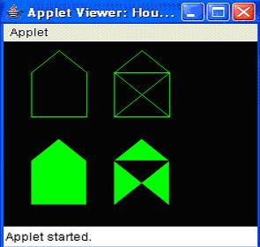

Slide 37
Working with Frame Windows
After the applet, the type of window most often create is derived from Frame.
to create child windows within applets, and top-level or child windows for stand-alone applications.
As mentioned, it creates a standard-style window.
Here are two of Frame’s constructors:
Frame( )
Frame(String title)
The first form creates a standard window that does not contain a title.
The second form creates a window with the title specified by title.
Notice that you cannot specify the dimensions of the window. Instead, you must set the size of the window after it has been created.

Slide 38
Setting the Window’s Dimensions
The setSize( ) method is used to set the dimensions of the window.
Its signature :
void setSize(int newWidth, int newHeight)
void setSize(Dimension newSize)
The dimensions are specified in terms of pixels.
The getSize( ) method is used to obtain the current size of a window. Its signature is
Dimension getSize( )
This method returns the current size of the window contained within the width and height fields of a Dimension object.

Slide 39
Hiding and Showing a Window
After a frame window has been created, it will not be visible until you call setVisible( ).
Its signature is shown here:
void setVisible(boolean visibleFlag)
The component is visible if the argument to this method is true. Otherwise, it is hidden.
Setting a Window’s Title
To change the title in a frame window using setTitle( ), which has this general form:
void setTitle(String newTitle)
Here, newTitle is the new title for the window.
Closing a Frame Window
When using a frame window, your program must remove that window from the screen when
it is closed, by calling setVisible(false).
To intercept a window-close event, you must implement the windowClosing( ) method of the WindowListener interface.
Inside windowClosing( ), you must remove the window from the screen.

Slide 40
Creating a Windowed Program
// Create an AWT-based application.
import java.awt.*;
import java.awt.event.*;
import java.applet.*;
// Create a frame window.
public class AppWindow extends Frame {
String keymsg = "This is a test.";
String mousemsg = "";
int mouseX=30, mouseY=30;

Slide 41
public AppWindow() {
addKeyListener(new MyKeyAdapter(this));
addMouseListener(new MyMouseAdapter(this));
addWindowListener(new MyWindowAdapter());
}
public void paint(Graphics g) {
g.drawString(keymsg, 10, 40);
g.drawString(mousemsg, mouseX, mouseY);
}
// Create the window.
public static void main(String args[]) {
AppWindow appwin = new AppWindow();
appwin.setSize(new Dimension(300, 200));
appwin.setTitle("An AWT-Based Application");
appwin.setVisible(true);
} }

Slide 42
class MyKeyAdapter extends KeyAdapter {
AppWindow appWindow;
public MyKeyAdapter(AppWindow appWindow) {
this.appWindow = appWindow;
}
public void keyTyped(KeyEvent ke) {
appWindow.keymsg += ke.getKeyChar();
appWindow.repaint();
};
}

Slide 43
class MyMouseAdapter extends MouseAdapter {
AppWindow appWindow;
public MyMouseAdapter(AppWindow appWindow) {
this.appWindow = appWindow;
}
public void mousePressed(MouseEvent me) {
appWindow.mouseX = me.getX();
appWindow.mouseY = me.getY();
appWindow.mousemsg = "Mouse Down at " + appWindow.mouseX +
", " + appWindow.mouseY;
appWindow.repaint();
} }
class MyWindowAdapter extends WindowAdapter {
public void windowClosing(WindowEvent we) {
System.exit(0);
} }

Slide 44
output

Slide 45
Colors and Fonts
java.awt.Color
The class java.awt.Color provides 13 standard colors as named-constants. They are: Color.RED, GREEN, BLUE, MAGENTA, CYAN, YELLOW, BLACK, WHITE, GRAY, DARK_GRAY, LIGHT_GRAY, ORANGE, and PINK. (In JDK 1.1, these constant names are in lowercase, e.g., red. This violates the Java naming convention for constants. In JDK 1.2, the uppercase names are added. The lowercase names were not removed for backward compatibility.)
You can use the toString() to print the RGB values of these color (e.g., System.out.println(Color.RED)):

Slide 46
RED : java.awt.Color[r=255, g=0, b=0]
GREEN : java.awt.Color[r=0, g=255, b=0]
BLUE : java.awt.Color[r=0, g=0, b=255]
YELLOW : java.awt.Color[r=255, g=255, b=0]
MAGENTA : java.awt.Color[r=255, g=0, b=255]
CYAN : java.awt.Color[r=0, g=255, b=255]
WHITE : java.awt.Color[r=255, g=255, b=255]
BLACK : java.awt.Color[r=0, g=0, b=0]
GRAY : java.awt.Color[r=128, g=128, b=128]
LIGHT_GRAY: java.awt.Color[r=192, g=192, b=192]
DARK_GRAY : java.awt.Color[r=64, g=64, b=64]
PINK : java.awt.Color[r=255, g=175, b=175]
ORANGE : java.awt.Color[r=255, g=200, b=0]

Slide 47
can also use the RGB values or RGBA value (A for alpha to specify transparency/opaque) to construct your own color via constructors:
Color(int r, int g, int b); // between 0 and 255
Color(float r, float g, float b); // between 0.0f and 1.0f
Color(int r, int g, int b, int alpha); // between 0 and 255
Color(float r, float g, float b, float alpha); // between 0.0f and 1.0f
// alpha of 0 for totally transparent, 255 (or 1.0f) for totally opaque
// The default alpha is 255 (or 1.0f) for totally opaque
For example:
Color myColor1 = new Color(123, 111, 222);
Color myColor2 = new Color(0.5f, 0.3f, 0.1f);
Color myColor3 = new Color(0.5f, 0.3f, 0.1f, 0.5f); // semi-transparent

Slide 48
To retrieve the individual components, you can use getRed(), getGreen(), getBlue(), getAlpha(), etc.
To set the background and foreground (text) color of a component/container, you can invoke:
JLabel label = new JLabel("Test");
label.setBackground(Color.LIGHT_GRAY);
label.setForeground(Color.RED);
To set the color of the Graphics context g (for drawing lines, shapes, and texts), use g.setColor(color):
g.setColor(Color.RED);
g.drawLine(10, 20, 30, 40); // in Color.RED
Color myColor = new Color(123, 111, 222);
g.setColor(myColor);
g.drawRect(10, 10, 40, 50); // in myColor

Slide 49
java.awt.Font
The class java.awt.Font represents a specific font face, which can be used for rendering texts. You can use the following constructor to construct a Font instance:
public Font(String name, int style, int size);
// name: Family name "Dialog", "DialogInput", "Monospaced", "Serif", or "SansSerif" or
// Physical font found in this GraphicsEnvironment.
// You can also use String constants Font.DIALOG, Font.DIALOG_INPUT, Font.MONOSPACED,
// Font.SERIF, Font.SANS_SERIF (JDK 1.6)
// style: Font.PLAIN, Font.BOLD, Font.ITALIC or Font.BOLD|Font.ITALIC (Bit-OR)
// size: the point size of the font (in pt) (1 inch has 72 pt).

Slide 50
You can use the setFont() method to set the current font for the Graphics context g for rendering texts. For example,
Font myFont1 = new Font(Font.MONOSPACED, Font.PLAIN, 12);
Font myFont2 = new Font(Font.SERIF, Font.BOLD | Font.ITALIC, 16); // bold and italics
JButton btn = new JButton("RESET");
btn.setFont(myFont1);
JLabel lbl = new JLabel("Hello");
lbl.setFont(myFont2);
......
g.drawString("In default Font", 10, 20); // in default font
Font myFont3 = new Font(Font.SANS_SERIF, Font.ITALIC, 12);
g.setFont(myFont3);
g.drawString("Using the font set", 10, 50); // in myFont3

Slide 51
Font's Family Name vs. Font Name
A font could have many faces (or style), e.g., plain, bold or italic. All these faces have similar typographic design. The font face name, or font name for short, is the name of a particular font face, like "Arial", "Arial Bold", "Arial Italic", "Arial Bold Italic". The font family name is the name of the font family that determines the typographic design across several faces, like "Arial". For example,
java.awt.Font[family=Arial,name=Arial,style=plain,size=1]
java.awt.Font[family=Arial,name=Arial Bold,style=plain,size=1]
java.awt.Font[family=Arial,name=Arial Bold Italic,style=plain,size=1]
java.awt.Font[family=Arial,name=Arial Italic,style=plain,size=1]

Slide 52
GraphicsEnvironment's getAvailableFontFamilyNames() and getAllFonts()
You can use GraphicsEnvironment's getAvailableFontFamilyNames() to list all the font famiy names; and getAllFonts() to construct all Font instances (with font size of 1 pt). For example,
GraphicsEnvironment env = GraphicsEnvironment.getLocalGraphicsEnvironment();
// Get all font family name in a String[]
String[] fontNames = env.getAvailableFontFamilyNames();
for (String fontName : fontNames) {
System.out.println(fontName); }
// Construct all Font instance (with font size of 1)
Font[] fonts = env.getAllFonts();
for (Font font : fonts) {
System.out.println(font); }

Slide 53
Logical Font vs. Physical Font
JDK supports these logical font family names: "Dialog", "DialogInput", "Monospaced", "Serif", or "SansSerif". JDK 1.6 provides these String constants: Font.DIALOG, Font.DIALOG_INPUT, Font.MONOSPACED, Font.SERIF, Font.SANS_SERIF.
Physical font names are actual font libraries such as "Arial", "Times New Roman" in the system.

Slide 54
Font's deriveFont()
You can use Font's deriveFont() to derive a new Font instance from this Font with varying size, style and others.
public Font deriveFont(float size)
public Font deriveFont(int style)
public Font deriveFont(AffineTransform trans)
public Font deriveFont(int style, float size)
public Font deriveFont(int style, AffineTransform trans)
For example,
Font font = new Font(Font.MONOSPACED, Font.BOLD, 12);
System.out.println(font);
// java.awt.Font[family=Monospaced,name=Monospaced,style=bold,size=12]
Font fontDerived = font.deriveFont(20);
System.out.println(fontDerived);
// java.awt.Font[family=Monospaced,name=Monospaced,style=plain,size=12]

Slide 55
(Advanced) java.awt.FontMetrics
The java.awt.FontMetrics class can be used to measure the exact width and height of the string for a particular font face, so that you can position the string as you desire (such as at the center of the screen).
To create a FontMetrics, use getFontMetrics() methods of the Graphics class, as follows:
// In java.awt.Graphics
public abstract FontMetrics getFontMetrics(Font f)
// Get the FontMetrics of the specified font
public abstract FontMetrics getFontMetrics()
// Get the FontMetrics of the current font

Slide 56
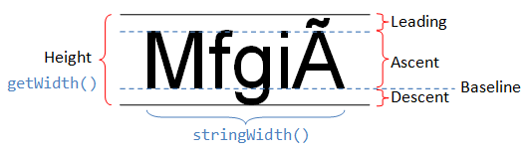
// in java.awt.FontMetrics
public int getHeight()
public int getLeading()
public int getAscent()
public int getDescent()

Slide 57
The most commonly-used function for FontMetrics is to measure the width of a given String displayed in a certain font.
public int stringWidth(String str)
// Returns the total width for showing the specified String in this Font.
To centralize a string on the drawing canvas (e.g., JPanel):
public void paintComponent(Graphics g) {
super.paintComponent(g);
g.setFont(new Font("Arial", Font.BOLD, 30));
// Get font metrics for the current font
FontMetrics fm = g.getFontMetrics();
// Centralize the string
String msg = "Hello, world!";
int msgWidth = fm.stringWidth(msg);
int msgAscent = fm.getAscent();
// Get the position of the leftmost character in the baseline
// getWidth() and getHeight() returns the width and height of this component
int msgX = getWidth() / 2 - msgWidth / 2;
int msgY = getHeight() / 2 + msgAscent / 2;
g.drawString(msg, msgX, msgY); }

Slide 58
Drawing Images
javax.swing.ImageIcon
The javax.swing.ImageIcon class represents an icon, which is a fixed-size picture, typically small-size and used to decorate components. To create an ImageIcon:
// Prepare an ImageIcons to be used with JComponents or drawImage()
String imgNoughtFilename = "images/nought.gif";
ImageIcon iconNought = null;
URL imgURL = getClass().getClassLoader().getResource(imgNoughtFilename);
if (imgURL != null) {
iconNought = new ImageIcon(imgURL);
} else {
System.err.println("Couldn't find file: " + imgNoughtFilename);
}

Slide 59
Graphics Class' drawImage()
ImageIcon is fixed-in-sized and cannot be resized in display. You can use Graphics's drawImage() to resize a source image in display.
The java.awt.Graphics class declares 6 overloaded versions of abstract method drawImage().
public abstract boolean drawImage(Image img, int x, int y, ImageObserver observer)
public abstract boolean drawImage(Image img, int x, int y, int width, int height, ImageObserver observer)
public abstract boolean drawImage(Image img, int x, int y, Color bgcolor, ImageObserver observer)
public abstract boolean drawImage(Image img, int x, int y, int width, int height, Color bgcolor, ImageObserver observer)
// The img is drawn with its top-left corner at (x, y) scaled to the specified width and height
// (default to the image's width and height).
// The bgColor (background color) is used for "transparent" pixels.
public abstract boolean drawImage(Image img, int destX1, int destY1, int destX2, int destY2,
int srcX1, int srcY1, int srcX2, int srcY2, ImageObserver observer)
public abstract boolean drawImage(Image img, int destX1, int destY1, int destX2, int destY2,
int srcX1, int srcY1, int srcX2, int srcY2, Color bgcolor, ImageObserver observer)
// The img "clip" bounded by (scrX1, scrY2) and (scrX2, srcY2) is scaled and drawn from
// (destX1, destY1) to (destX2, destY2) on the display.

Slide 60
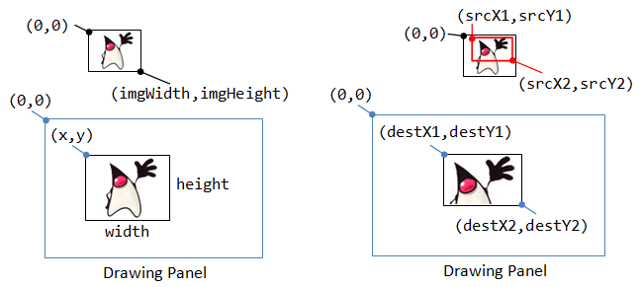

Slide 61
// Prepare an ImageIcon
ImageIcon icon = null;
String imgFilename = "images/duke.gif";
java.net.URL imgURL = getClass().getClassLoader().getResource(imgFilename);
if (imgURL != null) {
icon = new ImageIcon(imgURL);
} else {
System.err.println("Couldn't find file: " + imgFilename);
}
// Prepare an Image object to be used by drawImage()
final Image img = icon.getImage();
// Extend a JLabel and override paintComponet() to drawImage()
JLabel lbl4 = new JLabel() {
@Override public void paintComponent(Graphics g) {
super.paintComponent(g); // paint background
g.drawImage(img, 0, 0, 200, 200, null);
}
};
lbl4.setPreferredSize(new Dimension(200, 200));
cp.add(lbl4);

Slide 62
Introduction to Event-Driven Programming
With the development of a program with a graphical user interface (GUI) normally you want something to happen when the user performs certain actions, for example:
Clicking on an area of the interface using the mouse
Pressing a labelled button
Entering text into a text field
In each of these cases, a program 'event' occurs, and the program can be designed to incorporate specific actions that would occur when different events occur. This type of program is referred to as an event-driven program.
In event-driven programs, the program is said to run in a 'main loop', referred to as an event loop. When some user input occurs, then the program responds appropriately. The program will be in one state prior to the event occurring, and will usually be in a different state after the program has responded to the event.

Slide 63
Two mechanisms:
Delegation Event Model
The modern approach to handling events is based on the delegation event model,
standard and consistent mechanisms to generate and process events.
Its concept is quite simple:
a source generates an event and sends it to one or more listeners. In this scheme, the listener simply waits until it receives an event. Once an event is received, the listener processes the event and then returns.
The advantage of this design is that the application logic that processes events is cleanly separated from the user interface logic that generates those events.
A user interface element is able to “delegate” the processing of an event to a separate piece of code.
In the delegation event model, listeners must register with a source in order to receive an event notification.
This provides an important benefit: notifications are sent only to listeners that want to receive them.
Previously, an event was propagated up the containment hierarchy until it was handled by a component. This required components to receive events that they did not process, and it wasted valuable time. The delegation event model eliminates this overhead.

Slide 64
Thrown exceptions in an event-driven program are handled differently to standard programs with linear control structures.
If an exception is thrown and not caught, only the thread that the event handler was running in terminates -- not the entire program. In practice, what this means is that the program continues to run, but only part of the event handling code ends up being run (it runs up until the exception occurred.)
It's still necessary to catch and handle exceptions in an event-driven program, though, because running only part of an event's code can leave the program in an invalid state.

Slide 65
Responding to Events
For a program to respond to events, there are a number of 'parties' involved in events and event handling, as shown here.
Three parties are involved in the Java event model:
The event object: the event (e.g. mouse events): this holds properties associated with the event.
The event source: This object generates the event (for eg, a button) and manages the listeners.
The event listener: the object that is interested in the event (and will handle the event). An event listener is an object of a class that implements one or more of the standard event listener interfaces

Slide 66
Any type of object can be made into a listener by having it implement a Listener interface. The code that will process the event is implemented in a method which is declared in the listener interface. In this model:
Objects interested in some particular event register themselves with the relevant event source as event listeners.
Once that event occurs within the source, an object is created to represent the event and is fired to any registered listeners to be handled there.
Many components (for eg, buttons, text fields, etc) can be event sources and automatically generate event objects when certain user actions occur (for example, mouse clicking on a button.)

Slide 67
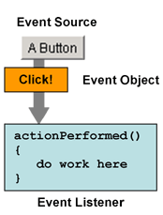
event model diagram

Slide 68

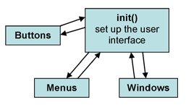

Slide 69
Event Classes
The ActionEvent Class

Slide 70
The AdjustmentEvent Class

Slide 71
The containerevent class
The FocusEvent Class
The InputEvent Class
The ItemEvent Class
The KeyEvent Class
The MouseEvent Class
The MouseWheelEvent Class
The TextEvent class
The WindowEvent Class

Slide 72
Sources of events

Slide 73
Event Objects
Event objects encapsulate all of the information related to a particular event that has occurred. For example, a mouse event object encapsulating a mouse-click might store the coordinates at which the click occurred, the object that the event originated from, and what mouse button was used to perform the click.
Let's look in detail at another example: clicking a button component on the screen. To detect when the user clicks an on-screen button:
the program must have an object that implements the ActionListener interface
the program must register this object as an action listener for the button, which is the event source, using the addActionListener() method
when the user clicks the button, the button 'fires' an action event.
This results in the calling of the action listener's actionPerformed() method (which is the only method in the ActionListener interface), and the single argument passed to this method is the ActionEvent object with info about the event.

Slide 74
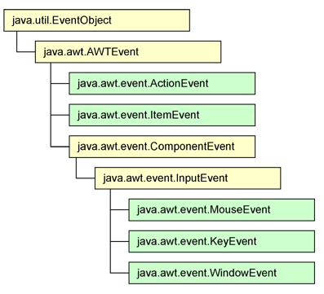
The Event Hierarchy
All event classes are descendants of java.util.EventObject.
We are only interested in AWT events in java.awt.event package.

Slide 75
Event Listeners
In order for the event mechanism to work, it is necessary to register a listener class for each user interface component. There are a varying number of listener interfaces that are suited to different event types. Generally speaking, for every kind of event object, there is a corresponding event listener. (Some event listeners share event objects, though; for example, both MouseListener and MouseMotionListener have their event object as MouseEvent.
A short summary of common event types is as follows:
User actions like clicking a button are modelled by an ActionEvent, and sent to an ActionListener.
Window actions like clicking a close or minimise box are WindowEvents, sent to WindowListeners.
Mouse actions like pressing the mouse is modelled in a MouseEvent, and is sent to a MouseListener.
Mouse movement is modelled in a MouseEvent, and is sent to a MouseMotionListener.
Key presses are modelled in a KeyEvent, and is sent to a KeyListener.
If a listener for a certain event is not registered to a component, the events are ignored. Conversely, an event source may have more than one listener registered for a particular event type (e.g. a button could have two ActionListeners registered to it.) In this circumstance, both listeners would be fired the same event object.

Slide 76
EventListener interfaces

Slide 77
Adapter Classes
provides an empty implementation of all methods in an event listener interface
Commonly used adapter classes

Slide 78
Using Events
In order to use events, we must do the following:
choose what event type is most appropriate
implement the corresponding event listener
register that listener implementation to an event source
Event Listeners
Listeners are interfaces from the java.awt.event package.
These interfaces define methods to handle corresponding events. For instance, ActionListener has one method:
public void actionPerformed(ActionEvent e);
MouseListener has five:
public void mouseClicked(MouseEvent e);
public void mouseEntered(MouseEvent e);
public void mouseExited(MouseEvent e);
public void mousePressed(MouseEvent e);
public void mouseReleased(MouseEvent e);

Slide 79
Any class implementing a listener must implement all the listener's methods.
The implemented methods say what happens when each of the specified events occurs.
If we're not interested in one of the event listener's methods, we need to implement it with a blank implementation.

Slide 80
A component can only recognise the occurrence of an event if it has registered a listener for that event. Unless an event listener has, in effect, said: "I want to know when the mouse is clicked on that component", it is not made aware of any mouse clicks that occur. An event listener declares an interest in knowing about an event by registering itself as a listener for a component.
All components have a number of methods with the general naming convention of add-type-Listener(), where -type indicates the type of listener that may be used by this component. The basic Component class itself has many of these listener registering methods. The most useful ones are:
addFocusListener() - for when the component has keyboard focus
addKeyListener() - for when a key is pressed when the component is active
addMouseListener() - to find out about mouse actions on the component
addMouseMotionListener() - for detecting mouse movements on the component
addMouseWheelListener() - for detecting mouse wheel scroll events on the component
Some components designed for user interaction, such as buttons and text fields, can also have action listeners registered to them. These events capture when actions occur; such as clicking the button, or pressing enter on a text field.

Slide 81
Registering Listeners to a Source
Listeners are registered to the component by the use of an addXListener() method (where 'X' is the event type.) Different components can register different event types. For example consider registering an ActionListener to a button:
Button myButton;
userInterface.add(myButton);
myButton.addActionListener(new MyListener());
The listener must also be defined -- this is done by implementing the relevant listener interface in a class. (There are many variations on how this code can be arranged.)

Slide 82
Creating a Listener
class MyListener implements ActionListener
{
public void actionPerformed(ActionEvent e)
{
System.out.println("Button Pressed");
}
}
With this code, each time the button from the user interface is clicked, the string "Button Pressed" will be printed in the system console. The listener can also be defined in the same class as the program, or using inner classes or adapters (discussed later.)

Slide 83
A Simple Example
This program will draw a circle at the coordinates at which the mouse was clicked.
import java.awt.*;
import java.awt.event.*;
import javax.swing.*;
public class MTest extends JApplet
implements MouseListener {
public void init() {
implementing the mouse listener
this.addMouseListener(this); }

Slide 84
registering this object as a mouse listener
public void mouseReleased(MouseEvent e) {}
public void mouseClicked(MouseEvent e) {}
public void mouseEntered(MouseEvent e) {}
public void mouseExited(MouseEvent e) {}
blank implementations for unneeded mouse listener methods
public void mousePressed(MouseEvent e) {
Graphics g = this.getGraphics();
int x = e.getX();
int y = e.getY();
g.drawOval(x,y,20,20); } }

Slide 85
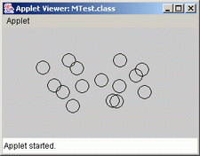

Slide 88
INTRODUCTION TO SWING
• The original Java GUI subsystem was the Abstract Window Toolkit (AWT).
• AWT translates it visual components into platform-specific equivalents (peers).
• Under AWT, the look and feel of a component was defined by the platform.
• AWT components are referred to as heavyweight.
• Swing was introduced in 1997 to fix the problems with AWT.
• Swing offers two key features:
1. Swing components are lightweight and don't rely on peers.
2. Swing supports a pluggable look and feel. The three PLAFs available to all users are Metal (default), Windows, and Motif.
• Swing is built on AWT.

Slide 89
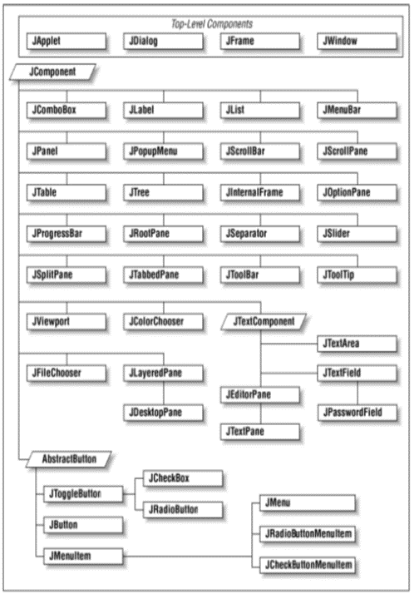

Slide 92
MVC in SWING

Slide 93
LAYOUT MANAGEMENT
Introduction to Layout Management
how to arrange these components inside a frame
JDK has no form designer
need to write code to position (lay out) the user interface components where you want them to be
Swing has plenty of layout managers available — both built-in and third-party. However,
most of the managers are not suitable in modern UI creation.
There are three layout managers that can do the job properly:
• MigLayout
• GroupLayout
• FormLayout
The following layout managers are obsolete:
• FlowLayout
• GridLayout
• CardLayout
• BoxLayout
• GridBagLayout

Slide 94
Border Layout
default layout manager of the content pane of every Jframe
completely controls the position of each component
lets you choose where you want to place each component
frame.add(component, BorderLayout.SOUTH);
The edge components are laid out first
remaining available space is occupied by the center
When the container is resized, the dimensions of the edge components are unchanged, but the center component changes its size
add components by specifying a constant CENTER, NORTH, SOUTH, EAST, or WEST of the BorderLayout class
If you don’t supply any value, CENTER is assumed

Slide 95
Grid Layout
arranges all components in rows and columns like a spreadsheet
All components are given the same size
When you resize the window, the buttons grow and shrink, but all buttons have identical sizes.

Slide 96
FlowLayout manager
FlowLayout()
FlowLayout(int align)
FlowLayout(int align, int hgap, int vgap)

Slide 97
SWING COMPONENTS
A component is an independent visual control.
Swing Framework contains a large set of components which provide rich functionalities and allow high level of customization.
They all are derived from JComponent class.
All these components are lightweight components.
pluggable look and feel, support for accessibility, drag and drop, layout, etc.
A container holds a group of components.
It provides a space where a component can be managed and displayed.

Slide 98
Containers are of two types,
Top level Containers
It inherits Component and Container of AWT.
It cannot be contained within other containers.
Heavyweight.
Example: JFrame, JDialog, JApplet
Lightweight Containers
It inherits JComponent class.
It is a general purpose container.
It can be used to organize related components together.
Example: Jpanel
JButton class provides functionality of a button. JButton class has three constuctors,
JButton(Icon ic)
JButton(String str)
JButton(String str, Icon ic)

Slide 99
TEXT FIELDS
JTextField is used for taking input of single line of text. It is most widely used text component. It has three constructors,
JTextField(int cols)
JTextField(String str, int cols)
JTextField(String str)
cols represent the number of columns in text field.

Slide 100
Example using JTextField
import javax.swing.*;
import java.awt.event.*;
import java.awt.*;
public class MyTextField extends JFrame
{
public MyTextField()
{
JTextField jtf = new JTextField(20); //creating JTextField.
add(jtf); //adding JTextField to frame.
setLayout(new FlowLayout());
setDefaultCloseOperation(JFrame.EXIT_ON_CLOSE);
setSize(400, 400);
setVisible(true);
}
public static void main(String[] args)
{
new MyTextField();
}
}

Slide 101
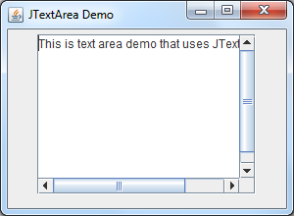
TEXT AREAS
we create a new text area using the JTextArea class.
Here is the screenshot of the demo application:

Slide 102
BUTTONS
package jtextareademo;
import javax.swing.*;
import java.awt.*;
public class Main {
public static void main(String[] args) {
final JFrame frame = new JFrame("JTextArea Demo");
JTextArea ta = new JTextArea(10, 20);
JScrollPane sp = new JScrollPane(ta);
frame.setLayout(new FlowLayout());
frame.setDefaultCloseOperation(JFrame.EXIT_ON_CLOSE);
frame.setSize(300, 220);
frame.getContentPane().add(sp);
frame.setVisible(true);
}}

Slide 103
Example using JButton
import javax.swing.*;
import java.awt.event.*;
import java.awt.*;
public class testswing extends JFrame
{
testswing() {
JButton bt1 = new JButton("Yes"); //Creating a Yes Button.
JButton bt2 = new JButton("No"); //Creating a No Button.
setDefaultCloseOperation(JFrame.EXIT_ON_CLOSE) //setting close operation.
setLayout(new FlowLayout()); //setting layout using FlowLayout object
setSize(400, 400); //setting size of Jframe
add(bt1); //adding Yes button to frame.
add(bt2); //adding No button to frame.
setVisible(true); }
public static void main(String[] args) {
new testswing(); }}

Slide 104
JCHECKBOX
JCheckBox class is used to create checkboxes in frame. Following is constructor for JCheckBox,
JCheckBox(String str)
Example using JCheckBox

Slide 105
import javax.swing.*;
import java.awt.event.*;
import java.awt.*;
public class Test extends JFrame{
public Test() {
JCheckBox jcb = new JCheckBox("yes"); //creating JCheckBox.
add(jcb); //adding JCheckBox to frame.
jcb = new JCheckBox("no"); //creating JCheckBox.
add(jcb); //adding JCheckBox to frame.
jcb = new JCheckBox("maybe"); //creating JCheckBox.
add(jcb); //adding JCheckBox to frame.
setLayout(new FlowLayout());
setDefaultCloseOperation(JFrame.EXIT_ON_CLOSE);
setSize(400, 400);
setVisible(true); }
public static void main(String[] args) {
new Test(); }}
Objects for the above components can be created by invoking its constructor . Let we see an example program

Slide 106
RADIO BUTTONS
Radio button is a group of related button in which only one can be selected. JRadioButton class is used to create a radio button in Frames. Following is the constructor for JRadioButton,
JRadioButton(String str)
Example using JRadioButton

Slide 107
import javax.swing.*;
import java.awt.event.*;
import java.awt.*;
public class Test extends JFrame
{
public Test() {
JRadioButton jcb = new JRadioButton("A"); //creating JRadioButton.
add(jcb); //adding JRadioButton to frame.
jcb = new JRadioButton("B"); //creating JRadioButton.
add(jcb); //adding JRadioButton to frame.
jcb = new JRadioButton("C"); //creating JRadioButton.
add(jcb); //adding JRadioButton to frame.
jcb = new JRadioButton("none");
add(jcb);
setLayout(new FlowLayout());
setDefaultCloseOperation(JFrame.EXIT_ON_CLOSE);
setSize(400, 400);
setVisible(true); }
public static void main(String[] args)
{
new Test(); }}

Slide 108
LISTS
Java.util.List is a child interface of Collection. List is an ordered collection of objects in which duplicate values can be stored. Since List preserves the insertion order it allows positional access and insertion of elements. List Interface is implemented by ArrayList, LinkedList, Vector and Stack classes.
Creating List Objects:
List is an interface, we can create instance of List in following ways:
List a = new ArrayList();
List b = new LinkedList();
List c = new Vector();
List d = new Stack(); Generic List Object:
After the introduction of Generics in Java 1.5, it is possible to restrict the type of object that can be stored in the List.

Slide 109
Operations on List:
List Interface extends Collection, hence it supports all the operations of Collection Interface and along with following operations:
1.Positional Access:
List allows add, remove, get and set operations based on numerical positions of elements in List. List provides following methods for these operations:
void add(int index,Object O): This method adds given element at specified index.
boolean addAll(int index, Collection c): This method adds all elements from specified collection to list. First element gets inserted at given index. If there is already an element at that position, that element and other subsequent elements(if any) are shifted to the right by increasing their index.
Object remove(int index): This method removes an element from the specified index. It shifts subsequent elements(if any) to left and decreases their indexes by 1.
Object get(int index): This method returns element at the specified index.
Object set(int index, Object new): This method replaces element at given index with new element. This function returns the element which was just replaced by new element

Slide 110
// Java program to demonstrate positional access
// operations on List interface
import java.util.*;
public class ListDemo {
public static void main (String[] args) {
// Let us create a list
List l1 = new ArrayList();
l1.add(0, 1); // adds 1 at 0 index
l1.add(1, 2); // adds 2 at 1 index
System.out.println(l1); // [1, 2]
// Let us create another list
List l2 = new ArrayList();
l2.add(1); l2.add(2); l2.add(3);
l1.addAll(1, l2); // will add list l2 from 1 index
System.out.println(l1);
l1.remove(1); // remove element from index 1
System.out.println(l1); // [1, 2, 3, 2]
System.out.println(l1.get(3)); // prints element at index 3
l1.set(0, 5); // replace 0th element with 5
System.out.println(l1); // [5, 2, 3, 2]
} }

Slide 111
2.Search:
List provides methods to search element and returns its numeric position. Following two methods are supported by List for this operation:
int lastIndexOf(Object o): This method returns the last occurrence of given element or -1 if element is not present in list.
Iteration: ListIterator(extends Iterator) is used to iterate over List element. List iterator is bidirectional iterator. For more details about ListIterator refer Iterators in Java.
Range-view: List Interface provides method to get List view of the portion of given List between two indices. Following is the method supported by List for range view operation.
List subList(int fromIndex,int toIndex):This method returns List view of specified List between fromIndex(inclusive) and toIndex(exclusive).

Slide 112
CHOICES
Creates an empty choice box; use addItem() to populate
import java.awt.*;
class ChoiceExample extends Frame
{
ChoiceExample()
{
setLayout(new FlowLayout());
Label lblCourse = new Label("Course");
Label lblweekDay = new Label("Day");
Choice course = new Choice();
course.add("BCA");
course.add("MCA");
course.add("MBA");
String[] day={"Mon","Tue","wed","Thu","fri","Sat","Sun"};
Choice weekDay =new Choice();
for(int i=0;i<day.length; i++)
{
weekDay.add(day[i]);
}
add(lblCourse); add(course);
add(lblweekDay); add(weekDay);
}
}
class ChoiceJavaExample
{
public static void main(String args[])
{
ChoiceExample frame = new ChoiceExample();
frame.setTitle("Choice in Java Example");
frame.setSize(250,100);
frame.setResizable(false);
frame.setVisible(true);
}
}

Slide 113
SCROLLBARS
The Scrollbar class embodies a scroll bar, a familiar user-interface object. A scroll bar provides a convenient means for allowing a user to select from a range of values. The following three vertical scroll bars could be used as slider controls to pick the red, green, and blue components of a color:
Each scroll bar in this example could be created with code similar to the following:
redSlider=new Scrollbar(Scrollbar.VERTICAL, 0, 1, 0, 255);
add(redSlider);
Alternatively, a scroll bar can represent a range of values. For example, if a scroll bar is used for scrolling through text, the width of the "bubble" (also called the "thumb" or "scroll box") can be used to represent the amount of text that is visible. Here is an example of a scroll bar that represents a range:
Image shows horizontal slider with starting range of 0 and ending range of 300. The slider thumb is labeled 60.

Slide 114
WINDOWS
A Window object is a top-level window with no borders and no menubar. The default layout for a window is BorderLayout. A window must have either a frame, dialog, or another window defined as its owner when it's constructed.
In a multi-screen environment, you can create a Window on a different screen device by constructing the Window with Window(Window, GraphicsConfiguration).
In a virtual device multi-screen environment in which the desktop area could span multiple physical screen devices, the bounds of all configurations are relative to the virtual device coordinate system. The origin of the virtual-coordinate system is at the upper left-hand corner of the primary physical screen. Depending on the location of the primary screen in the virtual device, negative coordinates are possible

Slide 115
MENUS
Menu menuView = new Menu ("View");
Once the Menu objects are created, we need to add them to the menu bar. For this, you have to use the add () method of the MenuBar class whose syntax is as follows,
Menu add (Menu menu)
where menu is Menu instance that is added to the menu bar. This method returns a reference to the menu. By default, consecutively added menus are positioned in the menu bar from left to right.
This makes the first menu added the leftmost menu and the last menu added the rightmost menu. If you want to add a menu at a specific location, then use the following version of add ()method inherited from the Container class.
Component add (Component menu, int index)
where menu is added to the menu bar at the specified index. Indexing begins at 0, with 0 being the leftmost menu. For example: In order to add menu instance menuFile to the menuBar use the following statement,
menuBar.add(menuFile);
Similarly, add other Menu instances menuEdit,menuView using the following statements,
menuBar.add(menuEdit);

Slide 116
menuBar.add(menuView);
import java.awt.*;
class MenuExample extends Frame
{
MenuExample()
{
MenuBar menuBar = new MenuBar();
setMenuBar(menuBar);
Menu menuFile = new Menu("File");
Menu menuEdit = new Menu("Edit");
Menu menuView = new Menu("View");
menuBar.add(menuFile);
menuBar.add(menuEdit);
menuBar.add(menuView);
MenuItem itemOpen = new MenuItem("Open");
MenuItem itemSave = new MenuItem("Save");
MenuItem itemExit = new MenuItem("Exit");
menuFile.add(itemOpen);
menuFile.add(itemSave);
menuFile.add(itemExit);
MenuItem itemcopy = new MenuItem("Copy");
menuEdit.add(itemcopy);
}
}
class MenuJavaExample
{
public static void main(String args[])
{
MenuExample frame = new MenuExample();
frame.setTitle("Menu in Java Example");
frame.setSize(350,250);
frame.setResizable(false);
frame.setVisible(true);
}}

Slide 117
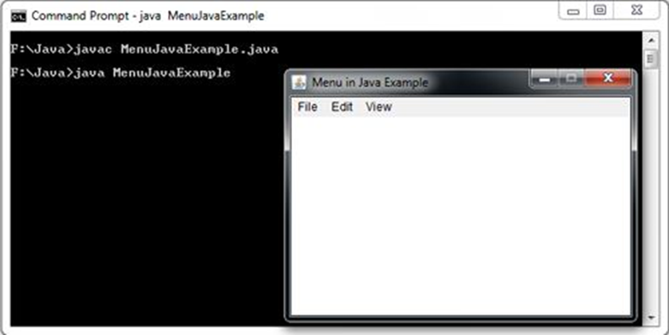

Slide 118
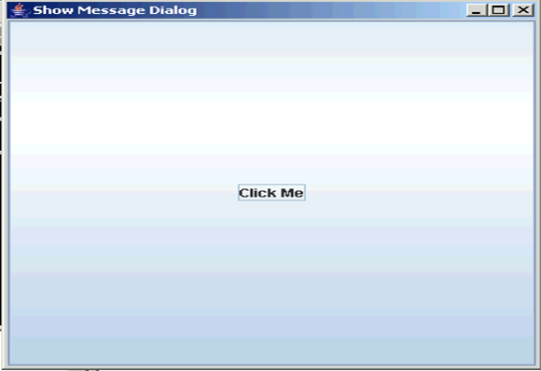
DIALOG BOXES
Message dialog box is used to display informative messages to the user. In this section we will use JOptionPane class to display the message Dialog box. Our program display "Click Me" button on the window and when user clicks on it program displays Message box with "OK" button and message "Roseindia.net".
When you run the program following window will be displayed:

Slide 119
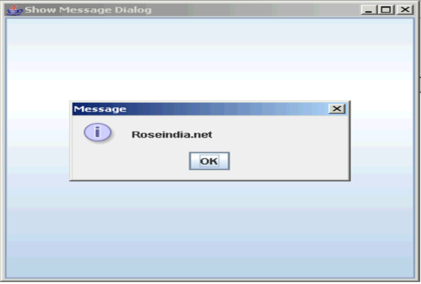
When you click on "Click Me" button, following Message is displayed:

Slide 120
Program description:
JOptionPane Class:
In non-swing application we were using System.in class for input or output some text or numeric values but now in the swing application we can use JOptionPane to show the output or show the message. This way of inputting or outputting works very efficiently in the Swing Applications. The window for showing message for input or output makes your application very innovative.
JOptionPane class is available in the javax.swing.*; package. This class provide various types of message dialog box as follows:
A simple message dialog box which has only one button i.e. "Ok". This type of message dialog box is used only for showing the appropriate message and user can finish the message dialog box by clicking the "Ok" button.
A message dialog box which has two or three buttons. You can set several values for viewing several message dialog box as follows:
1.) "Yes" and "No"
2.) "Yes", "No" and "Cancel"
3.) "Ok", and "Cancel"
A input dialog box which contains two buttons "Ok" and "Cancel".

Slide 121
The JOptionPane class has three methods as follows:
showMessageDialog(): First is the showMessageDialog() method which is used to display a simple message.
showInputDialog(): Second is the showInputDialog() method which is used to display a prompt for inputting. This method returns a String value which is entered by you.
showConfirmDialog(): And the last or third method is the showConfirmDialog() which asks the user for confirmation (Yes/No) by displaying message. This method return a numeric value either 0 or 1. If you click on the "Yes" button then the method returns 1 otherwise 0.
How program Works:
This program illustrates you how to show a message dialog box when you click on the button.

Slide 122
showMessageDialog():
This method is used to show a message dialog box which contains some text messages. This is being used with two arguments in the program where the first argument is the parent object in which the dialog box opens and another is the message which has to be shown.
Here is the code of the program:
import javax.swing.*;
import java.awt.event.*;
public class ShowDialogBox{
JFrame frame;
public static void main(String[] args){
ShowDialogBox db = new ShowDialogBox();
}
public ShowDialogBox(){
frame = new JFrame("Show Message Dialog");
JButton button = new JButton("Click Me");
button.addActionListener(new MyAction());
frame.add(button);
frame.setSize(400, 400);
frame.setVisible(true);
frame.setDefaultCloseOperation(JFrame.EXIT_ON_CLOSE);
}
public class MyAction implements ActionListener{
public void actionPerformed(ActionEvent e){
JOptionPane.showMessageDialog(frame,"Roseindia.net");
} }}
import javax.swing.JOptionPane;
public class Main {
public static void main(String[] argv) throws Exception {
JOptionPane.showMessageDialog(null, "I am happy.");
}}

Slide 123
Java Applet
Applet is a special type of program that is embedded in the webpage to generate the dynamic content. It runs inside the browser and works at client side.
Advantage of Applet
There are many advantages of applet. They are as follows:
It works at client side so less response time.
Secured
It can be executed by browsers running under many plateforms, including Linux, Windows, Mac Os etc.
Drawback of Applet
Plugin is required at client browser to execute applet.

Slide 124
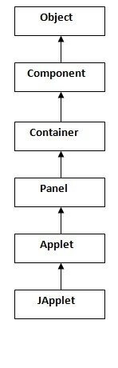
Hierarchy of Applet

Slide 125
Lifecycle of Java Applet
Applet is initialized.
Applet is started.
Applet is painted.
Applet is stopped.
Applet is destroyed.

Slide 126
java.applet.Applet class
For creating any applet java.applet.Applet class must be inherited. It provides 4 life cycle methods of applet.
public void init(): is used to initialized the Applet. It is invoked only once.
public void start(): is invoked after the init() method or browser is maximized. It is used to start the Applet.
public void stop(): is used to stop the Applet. It is invoked when Applet is stop or browser is minimized.
public void destroy(): is used to destroy the Applet. It is invoked only once.

Slide 127
Who is responsible to manage the life cycle of an applet?
Java Plug-in software.
How to run an Applet?
There are two ways to run an applet
By html file.
By appletViewer tool (for testing purpose).

Slide 128
Simple example of Applet by appletviewer tool:
To execute the applet by appletviewer tool, create an applet that contains applet tag in comment and compile it. After that run it by: appletviewer First.java. Now Html file is not required but it is for testing purpose only.
//First.java
import java.applet.Applet;
import java.awt.Graphics;
public class First extends Applet{
public void paint(Graphics g){
g.drawString("welcome to applet",150,150);
} }
/*
<applet code="First.class" width="300" height="300">
</applet>
*/
To execute the applet by appletviewer tool, write in command prompt:
c:\>javac First.java
c:\>appletviewer First.java

Slide 129
Simple example of Applet by html file:
To execute the applet by html file, create an applet and compile it. After that create an html file and place the applet code in html file. Now click the html file.
//First.java
import java.applet.Applet;
import java.awt.Graphics;
public class First extends Applet{
public void paint(Graphics g){
g.drawString("welcome",150,150);
} }
myapplet.html
<html>
<body>
<applet code="First.class" width="300" height="300">
</applet>
</body>
</html>

